Slide 1
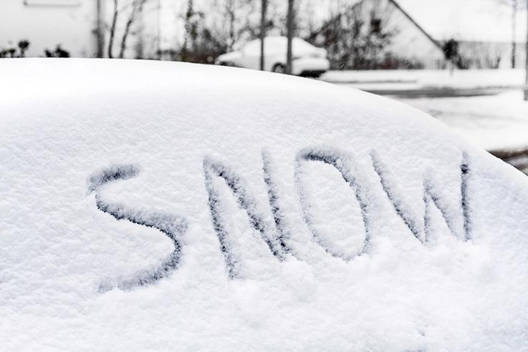
CULTURE, DIVERSITY & INCLUSION
Ivan Aguilera & Nick Gilewski

Slide 2
INTRODUCTION
Goal: Gain a better understanding on NYPA’s culture, diversity & conclusion
Organization Background
Literature Review
Research Purpose/Questions
Research Methods
Findings
Conclusion
Limitations

Slide 3
ORGANIZATION BACKGROUND
Robert Moses Power Plant:
Opened in 1961
Approximately 225 employees
Union & Non Union
21 Lines – 115kv, 230kv, 345kv
25 generators – 2675 MW

Slide 4
LITERATURE REVIEW
Focused on the following diversity topics
Women in Power
Supplier Diversity
Workforce Training Center
These topics became the criterion used to assess NYPA’s diversity efforts

Slide 5
RESEARCH PURPOSE
Determine the effectiveness of NYPA’s diversity initiatives relative to the criterion established

Slide 6
RESEARCH QUESTIONS
Women in Power
Are there any documented programs in place to help women achieve positions of power?
Are there examples of women who have either come up through the ranks or were hired externally in positions of power?
What is the highest position a female employee has attained in the organization? This could be currently employed or in the recent past.
How do employees feel about programs to help women achieve positions of power?

Slide 7
RESEARCH QUESTIONS
Supplier Diversity
Did the organization have a program in place to improve supplier diversity?
Did the organization provide statistics in terms of the percentage of minority suppliers in their supplier base?
Did the organization has goals/ targets to be achieved? Did they meet their targets?

Slide 8
RESEARCH QUESTIONS
Workforce Training Center
Does the organization have a formal workforce employment program?
What are the goals of the program?
How effective has the program been in hiring minority employees?

Slide 9
RESEARCH METHOD
Conducted interviews:
Human Resource Manager
Operations Supervisor
Electrical Planner/ Engineer
Conducted internal & External Literature Review:
Company Portal
World Wide Web
Attended events internally

Slide 10
FINDINGS
Interviews:
Over publicizing?
Participation
Perceived to do better than other workplaces
Quotas

Slide 11
FINDINGS
World Heritage Fair 2016
Literature Reviews:
Internal:
More info on intranet vs. internet
Diversity for the month
No quota for hiring
Metrics used to gauge diversity internally
External:
CEO - Gil Quinones
Lack of negative articles
Forbes 6th best utility to work for
Local events

Slide 12
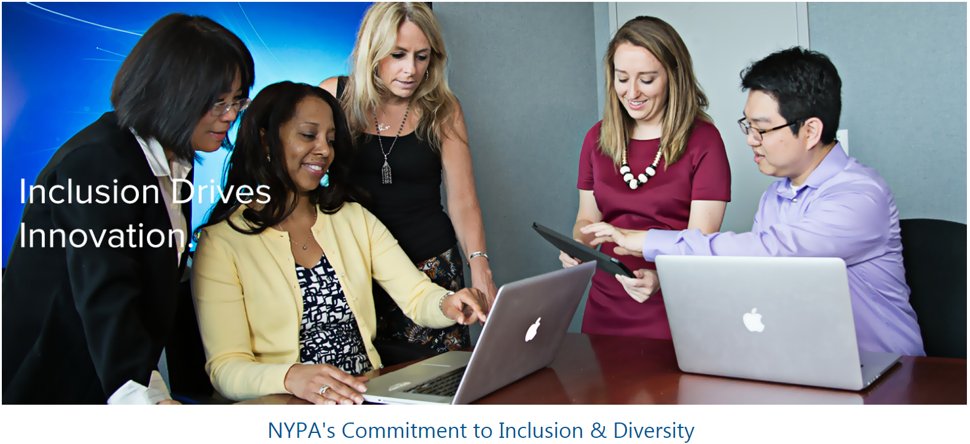

Slide 13
CONCLUSION
Let it happen naturally, it worked since 1961
Do not force feed
Limit window dressing
Acknowledge all employees

Slide 14
LIMITATIONS
Not as much info on world wide web vs. intra-net
Unable to interview union employee
Politically correct answers

Slide 15
DIVERSITY IN 1 MINUTE

Slide 16
QUESTIONS???

Slide 17
REFERENCES
Adobor, Henry (05/2007). "Supplier diversity and supply chain management: A strategic approach". Business horizons (0007-6813), 50 (3), p. 219.
Auster, E. R.: 1993, `Demystifying the Glass Ceiling: Organizational and Interpersonal Dynamics of Gender Bias', Business and the Contemporary World 5, 47-68.
Caminiti, S. (2006). “Drivers of the Economy”. Fortune, C1-C15.
Carbone, J. (2005). IBM says diverse suppliers are good for business. Purchasing, 134(13), 27-28.
Holzer, H. (2001). Career advancement prospects and strategies for low-wage minority workers. Low-wage workers in the new economy, 223-237.
Larson, A., & Freeman, R. E. (1997). Women's studies and business ethics: Toward a new conversation.
Oakley, J. G. (2000). Gender-based barriers to senior management positions: Understanding the scarcity of female CEOs. Journal of business ethics, 27(4), 321-334.
Morrison, A. M., R,. P. White, E. Van Velsor and The Center for Creative Leadership: 1987, Breaking the Glass Ceiling (Addison-Wesley, Reading, MA).
Murnane, Richard and Frank Levy. Teaching the New Basic Skills. New York: Free Press, 1995.
Niagara Frontier Publications (5/2018). “New York Power Authority featured on Forbes list of best employers for 2018” Retrieved from https://www.wnypapers.com/news/article/current/2018/05/03/132496/new-york-power-authority-featured-on-forbes-list-of-best-employers-for-2018
Worthington, Ian (11/2009). "Corporate Perceptions of the Business Case for Supplier Diversity: How Socially Responsible Purchasing can ‘Pay’". Journal of business ethics (0167-4544), 90 (1), p. 47.

