Slide 1
Clean Energy Convergence:
One Solution Leads to Another Problem
Quantitative Inferential Research Study
Nick E. Gilewski MSIT, MBA

Slide 2
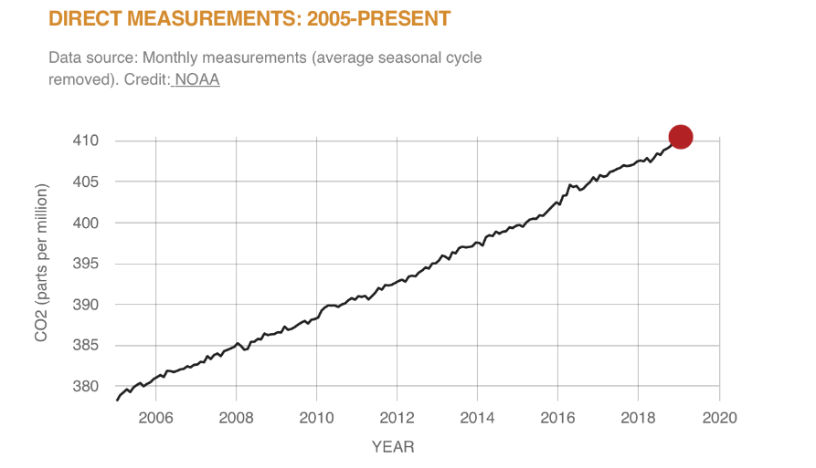
Problem - CO2 Emissions

Slide 3
My Experience and why its important to me?

Slide 4
Research Purpose
The study will investigate and analyze the impact clean energy has to bulk power reliability, security, distribution, and market while recognizing the importance and necessity for clean renewable energy and grid stability.

Slide 5
Research Question
What are the affects of clean energy integration on the electric power grid?

Slide 6
Rationale for the Study
The rationale for the study is that little to no research has been done towards minimizing or completely mitigating the causality of clean energy.

Slide 7
Theoretical Framework
A theoretical framework is proposed to illustrate the relationship between inverter-based generation (clean energy) and synchronous based generation (both clean and dirty energy)
The relationship visualization will identify clean energy convergence opportunities and solutions.

Slide 8
Clean Energy Convergence (Variables) Methodology
CO2 Emission
Frequency swings
Capacity swings due to inconsistent weather, resulting in inconsistent clean energy output
Grid reliability
Market inconsistency
Thermal degradation on cycling units, resulting in premature failure
The research study will be a quantitative inferential statistical analysis correlating clean energy and grid instability

Slide 9
Limitations and Delimitations
Zonal Differences
Independent Systems Operator vs. Non-Independent System Operators
Proprietary Information
Political Affiliation Creating Bias

Slide 10
Data Collection & Analysis
Instrumentation will include questionnaires and tests.
Data analysis and interpretation of the results will include statistics on the surveyed responses/collections. An inferential analysis of the dependent variables (outcome) will be provided.
Statistical software - SPSS

Slide 11
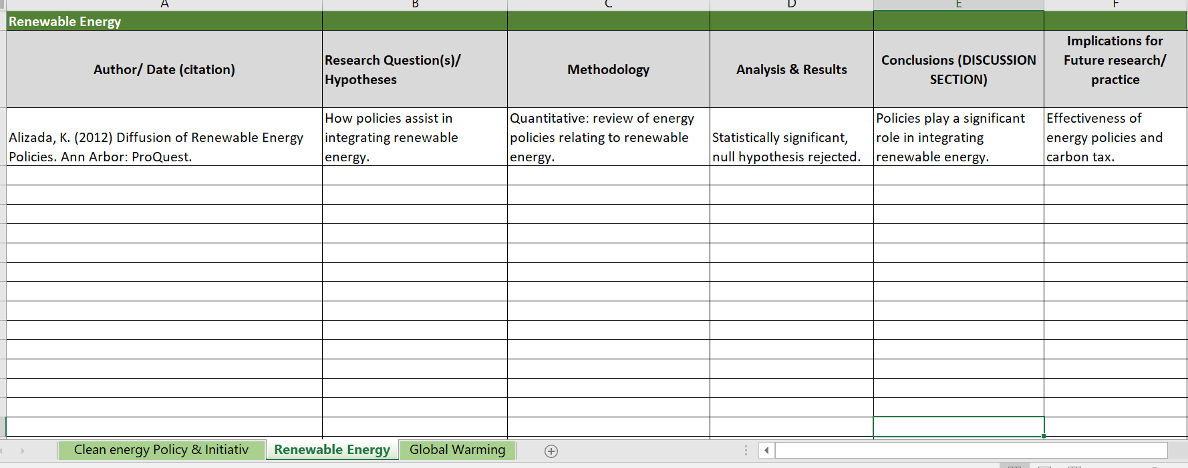
Reference Matrix

Slide 12
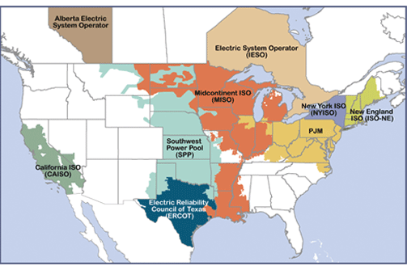
Independent System Operator Map

Slide 13
Questions? Thank you!

