Slide 1
MAY, 1985
Between 9.3 and 18.6 Miles

Slide 2
Montreal Protocol
The Montreal Protocol was introduced at the Vienna Convention for the Protection of the Ozone Layer in 1987
The Montreal Protocol was internationally agreed upon and enforced on September 16, 1989, following a meeting in Helsinki, May 1989. Since then, the Montreal Protocol has undergone eight revisions, in 1990 (London), 1991 (Nairobi), 1992 (Copenhagen), 1993 (Bangkok), 1995 (Vienna), 1997 (Montreal), 1998 (Australia), 1999 (Beijing), and 2016 (Kigali).
Every country on Earth

Slide 3
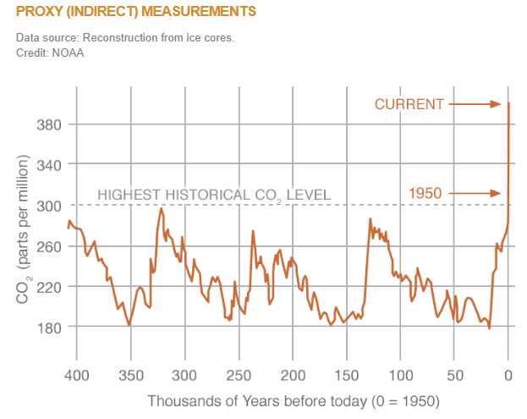
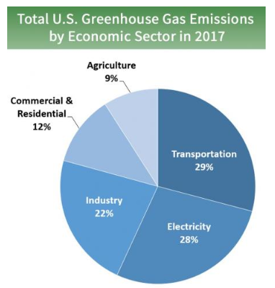
Global Warming & Climate Change
Carbon Emission Sources

Slide 4
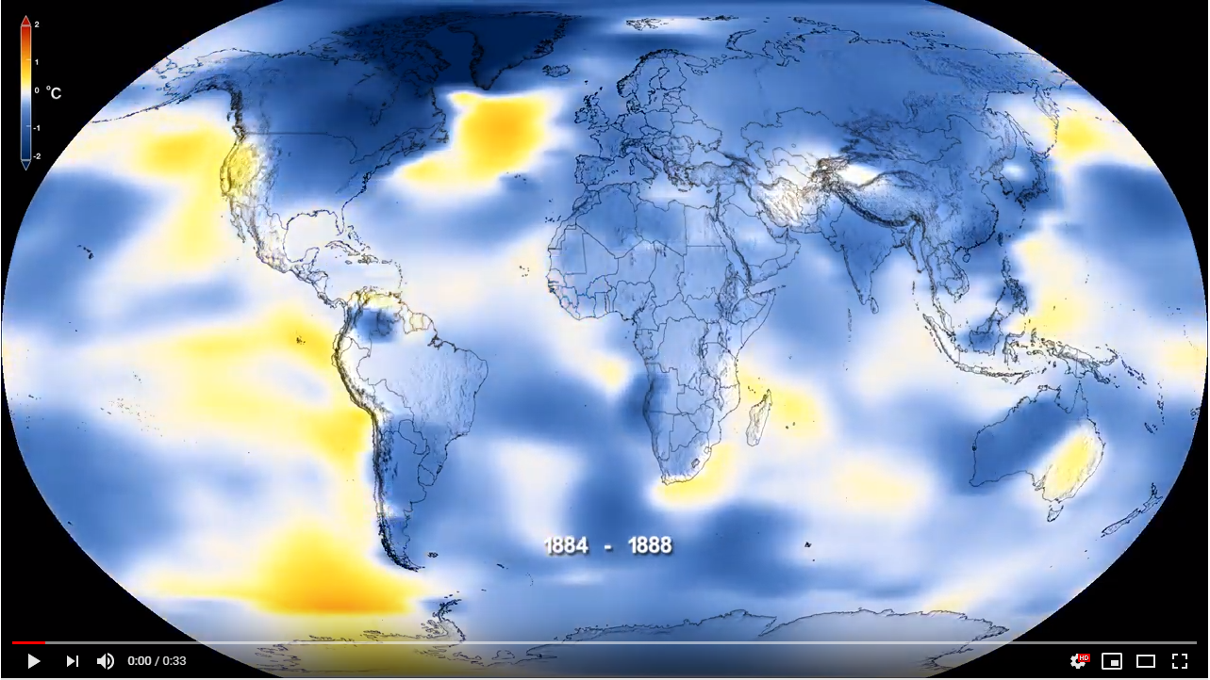
Global Warming & Climate Change

Slide 5
Carbon Pricing Proposal
2018
NEW YORK STATE

Slide 6
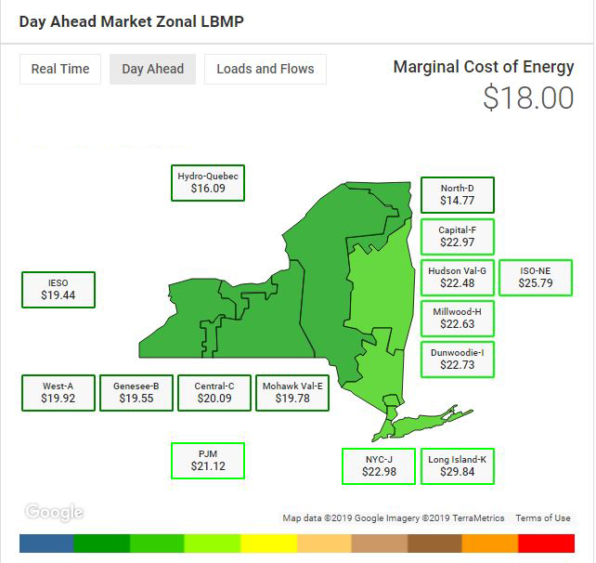
LBMP
Local Based Marginal Price
LBMPc
Local Based Marginal Price
+ Carbon Emission Tax

Slide 7
RESULTS
PROS
CONS
Removal of dirty energy generators.
Lower Carbon Dioxide Emission within NYS.
Cleaner environment, which could eliminate global warming.
Provide a synergy towards a greener consciences New York State.
Associated cost to the end user for a greener environment.
The resultant of the reduction of CO2 emissions does not mitigate global warming and climate change.
Recession could cause the energy market to surge.
My Critique
X

Slide 8
THANK YOU!
Nick E. Gilewski MSIT, MBA
QUESTIONS?

Slide 9
References
EIA. (2019, February 1). New York Net Electricity Generation by Source Dec. 2018. Retrieved from U.S. Energy Information Administration: https://www.eia.gov/state/?sid=NY#tabs-4
EIA, U. E. (2018, November 8). 2017 Carbon Dioxide Emissions at Electric Plants. Washington, District of Columbia, United States.
EPA . (n.d.). Greenhouse Gas Emissions. Retrieved from United States Environmental Protection Agency: https://www.epa.gov/ghgemissions/overview-greenhouse-gases
Handwerk, B. (2010, May 7). Whatever Happened to the Ozone Hole? Retrieved from National Geographic: https://news.nationalgeographic.com/news/2010/05/100505-science-environment-ozone-hole-25-years/
Lu, J. (2018, November 5). A new report shows the ozone hole is healing, but it's not all good news. Retrieved from Popular Science: https://www.popsci.com/2018-ozone-report-montreal-protocol
Newman, P. A. (2018, October 18). NASA Ozone Watch. Retrieved from NASA: https://ozonewatch.gsfc.nasa.gov/facts/hole_SH.html
NYISO . (2018, December 7). IPPTF Carbon Pricing Proposal. Retrieved from New York Independent System Operator: https://www.nyiso.com/documents/20142/3911819/Carbon-Pricing-Proposal%20December%202018.pdf
NYSERA. (n.d.). Acieving NY Energy Goals. Retrieved from New York State Energy Research and Development: https://www.nyserda.ny.gov/All-Programs/Programs/Energy-Storage/Achieving-NY-Energy-Goals
Welch, C. (n.d.). Ask The Scientist. Retrieved from The Ozone Hole: http://www.theozonehole.com/askthescientist.htm

