Slide 1
Chapter 10:
Change Practice, Not Principles
Nick, Clement and Caressa
Notes:
Nick the first 8 slides is the powerpoint.

Slide 2
Chapter and Article Overview
Article 1 Summary: Fonseca, L.M. and Domingues, J.P., (2017), “How to succeed in the digital age? Monitor the organizational context, identify risks and opportunities, and manage change effectively.”
https://www.degruyter.com/downloadpdf/j/mmcks.2017.12.issue-3/mmcks-2017-0027/mmcks-2017-0027.pdf
Article 2 Summary: Switzer, Cameron (2008), “Time for change: empowering organizations to succeed in the knowledge economy.”
https://search-proquest-com.ezproxy.niagara.edu/docview/230331355/475772E9D0E9435EPQ/6?accountid=28213

Slide 3
Change Vs. Evolve
Key Concepts
Change Evolve
Make or become different Develop gradually
Transformation Progression
Alteration Advancement
Expansion
Production
Embrace

Slide 4
Concepts of Successful Change Practices Not Principles...
Technology
Empowerment
Ownership
Culture
Reward/Incentive
Spot Check/Walk the talk
Notes:
Caressa

Slide 5
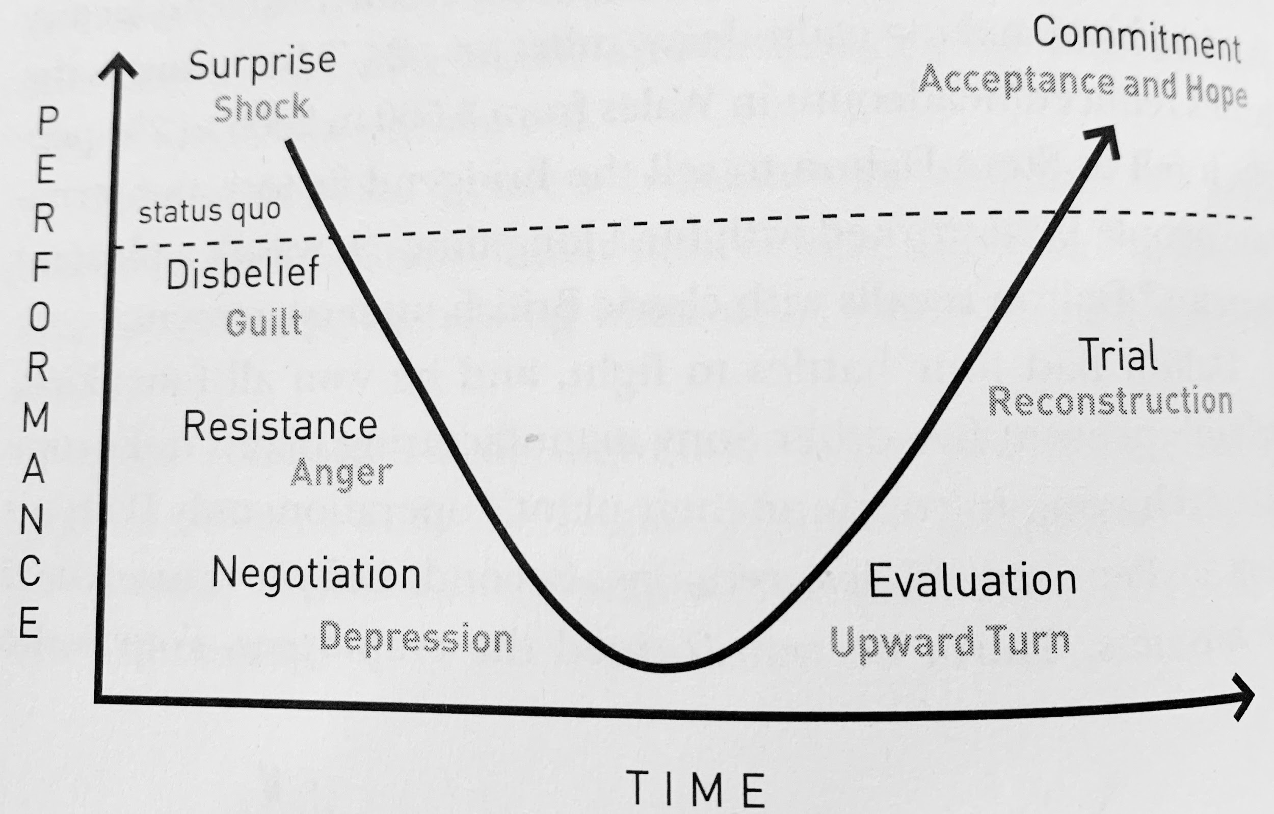
Change and Evolve
Notes:
Nick

Slide 6
Scenario of Toys R US
Anyone who wants to understand the failure of Toys R Us in bankruptcy is not going to suffer from a shortage of reasons: Amazon, Walmart, Target. E-commerce. Loss leaders. Price wars. Debt. Private equity. Kids who prefer screens to Super Soakers.
Chapter 11 Bankruptcy….
Notes:
Nick’s Segway for Clem’s activity

Slide 7
Activity
Visionary Team
Notes:
Clem’s insight and direction-15 - 20 minutes

Slide 8
Summary
How and what determined who went to the visionary team and did this decision impact the organization's ability to evolve by operating under the same principles while changing practices?
Why are these practices important for a business model and leadership within any organization?
Notes:
Caressa-closure

Slide 9
References
Bustin, G. (2014). Accountability: The Key to Driving a High-Performance Culture. New
York, NY: McGraw Hill Professional.
Fonseca, L. M., & Domingues, J. P. (2017). How to succeed in the digital age? Monitor
the organizational context, identify risks and opportunities, and manage change
effectively. Management & Marketing,12(3), 443-455. doi:10.1515/mmcks-2017-0027
Jacobs, G., Van Witteloostuijn, A., & Christe‐Zeyse, J. (2013). A theoretical framework
of organizational change. Journal of Organizational
Change Management, 26(5), 772-792. doi:10.1108/jocm-09-2012-0137
Switzer, C. (2008). Time for change: empowering organizations to succeed in the
knowledge economy. Journal of Knowledge Management,
12(2), 18-28. doi:10.1108/13673270810859488
Unglesbee, B. (2018, June 26). Inside the 20 year decline of Toys R US. Retrieved from
https://www.retaildive.com/news/inside-the-20-year-decline-of-toys-r-us/526364/

Slide 10
Procurement/Management Department
(Inside of the folder with survey)
"The end result was that if you wanted to work for us you had to be willing to be available at any time, willing to work a different schedule every week, willing to take a paycheck that was different every week and learn what your schedule was a few days in advance. Oh, and little-to-no company benefits."
Task: All members read the quote. Choose a person from your department to be on the visionary team to discuss one of the key concepts you agree fits with the quote presented.
Factors:
*The color chip represents seniority in the organization : Blue and has the most seniority, yellow and red are in the the middle, green is new staff
Years of Employment: 5-15 Years
Ages: 35 yrs old to 50 yrs old
Notes:
Slide to be printed for tables. Not apart of presentation--Already printed and done

Slide 11
Information Technology Department
Much as they miss — and depend on — their jobs with Toys R Us, employees are mourning the loss of the Toys R Us brand and the experiences they had in their stores. That is the main reason why Pena created the Facebook group, dubbed the "Dead Giraffe Society," a reference to what managers let go after the buyout were called. "It's a kind of bridge to the past," Pena said. "You can close down schools or shut down a business, but you can never take away the memories." According to Pena, the group grew to 7,000 members in just four days. As a rule, he wants the group to be a storehouse for positive memories, not recriminations.
Task: All members read the quote. Choose a person from your department to be on the visionary team to discuss one of the key concepts you agree fits with the quote presented.
Factors:
*The color chip represents seniority in the organization
Years of Employment: 2 - 5 years
Ages: Mid 20’s to Early 30’s
Notes:
Slide to be printed. Not apart of presentation--Already printed and done

Slide 12
Marketing
"[Babies R Us] has shown degradation in margin continuously even though we were told by customers that our prices were too high."Dave Brandon Former Toys R Us CEO
Last September, the retailer logged a 6.8% decline in comps it attributed primarily to a decline in the baby category, which in turn was caused by a decline in infant care products, baby gear and consumables like formula, according to regulatory filings.
Task: Task: All members read the quote. Choose a person from your department to be on the visionary team to discuss one of the key concepts you agree fits with the quote presented.
Factors:
*The color chip represents seniority in the organization
Years of Employment: At Least 5 years
Ages: Mid 20’s to Late 30’s
Notes:
Slide to printed. Not a part of presentation--already printed and done

Slide 13
Visionary Team
Based on the the key concepts each visionary member brought to the table and the initial scenario were the key concepts considered with the implementation of the practices?
“The immediate reasons for the the collapse of Toys R Us in bankruptcy are fairly straightforward, at least given what we know. (And there are a lot of details, mainly having to do with backroom negotiations among stakeholders, that we don't know.)”
Notes:
Already printed and done

