Slide 1
The Future of Green Energy in New York State
Nick E. Gilewski MSIT, MBA ADS830 Qualitative Research IRB Submittal

Slide 2
Introduction and Background
The New York State Clean Energy Standard is a mandate to get 50% of electricity in the State from renewable sources by 2030
Energy storage, increasing renewables, digitization, and a smart grid will play a critical role in achieving the goal of 50% by 2030.

Slide 3
GIS Research and Analysis
How is NYS going to achieve the Clean Energy Standard by 2030?
What are other states doing to increase renewables?
Federal and local incentives and policies?
Pollution correlation CO2 geographically.
Data analysis – Uncover relationships within the data, statistics, charts, and graphs using GIS.

Slide 4
Limitations and Strengths
Accessibility, biases, time consuming, and labor intensive - L
Ethical considerations – Difficult questions, disclosure of harm, consent, and confidentiality - L
Favorable accessibility - S
Subject matter expert - S

Slide 5
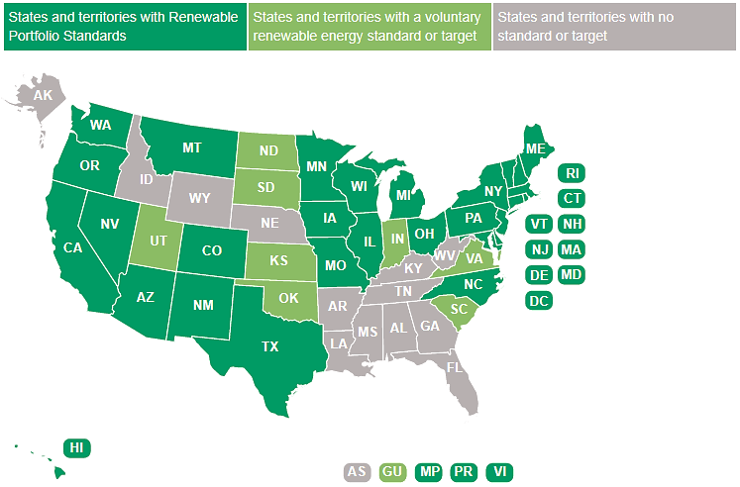
GIS Map of U.S.

Slide 6
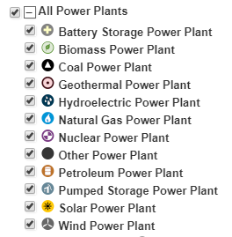
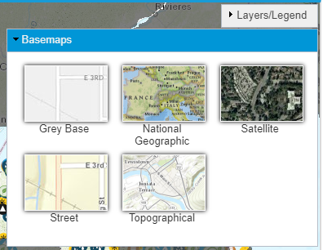
GIS Map Search Criteria

Slide 7
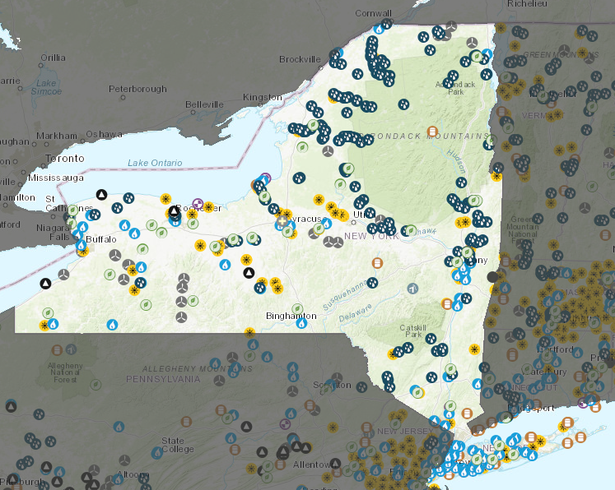
GIS Map in NYS Green Energy

Slide 8
GIS Research & Analysis
Questions?

